Slide 1
SOCIAL CHANGE
LECTURE#9
SHAHTAJ SHAKIR
LECTURER

Slide 2
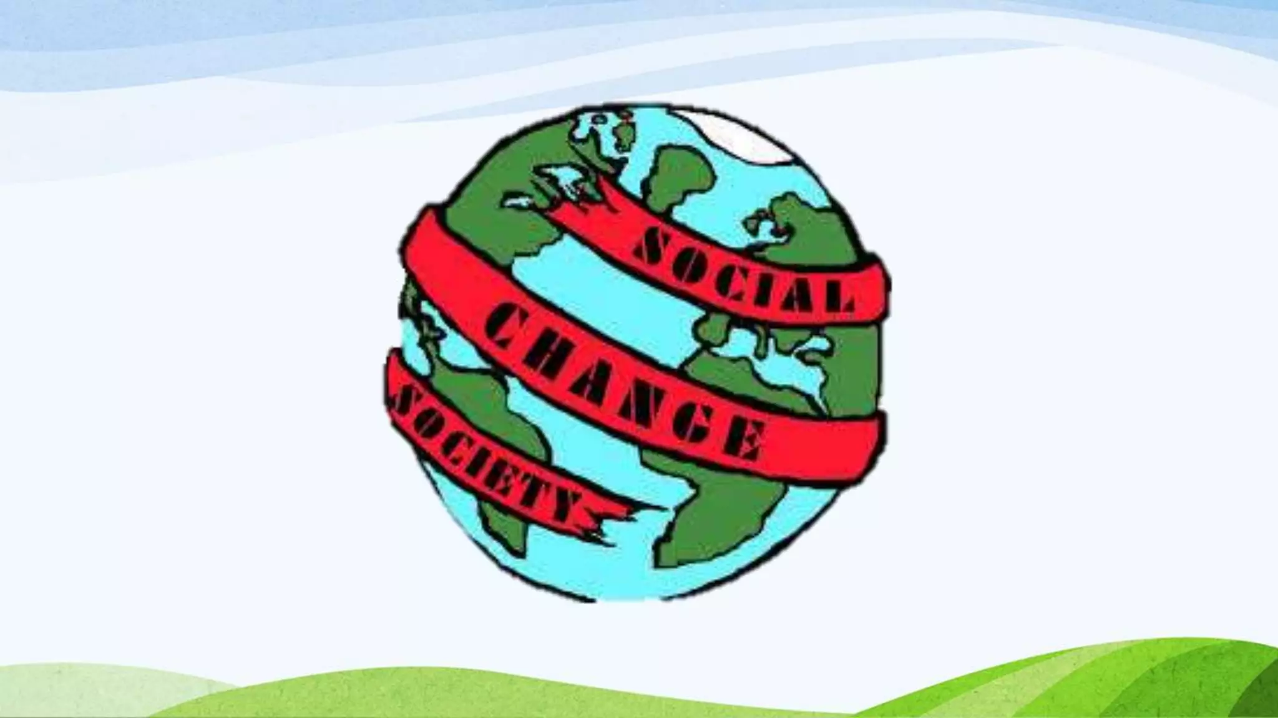
LEARNING OUTCOMES
Define and describe the nature of social change;
Differentiate the important theoretical approaches to social change;
Discuss the factors that play an important role in bringing about social change; and State the importance of analyzing social change.

Slide 3
MEANING AND NATURE OF SOCIAL CHANGE
The concepts of social control, deviance and conflict. All these concepts help us to understand the universal process of change in society.
From its inception, sociology has been closely linked with the study of the rapid changes in societies.
“Social change refers to fundamental alterations in the patterns of culture, structure, social insitutions, and social behavior over time.”

Slide 4
In sociology, we look at social change as alterations that occur in the social structure and social relationship.
Alterations may occur in norms, values, cultural products and symbols in a society.
The social change is also known as social progress or sociocultural evolution.
Example:
1. A significant social change occurred in the form of drastic shift from an agricultural society to industrialized and post-modern society.
2. Change in family system.
3. Change in education system.
4. Globalization (media exchange, cultural variations)

Slide 5

Food for thought
Internet has changed socialization, human interaction, banking, shopping other mode of living etc.
Is every kind of social change good for us???

Slide 6
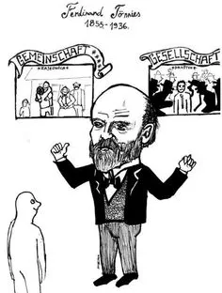
From Gemeinschaft to Gesellschaft
Introduced by German sociologist Ferdinand Tönnies, Gemeinschaft and Gesellschaft are two conceptual models for types of human association.
Gemeinschaft, often translated as ” community “, is a concept referring to individuals bound together by common norms, often because of shared physical space and shared beliefs.

Slide 7
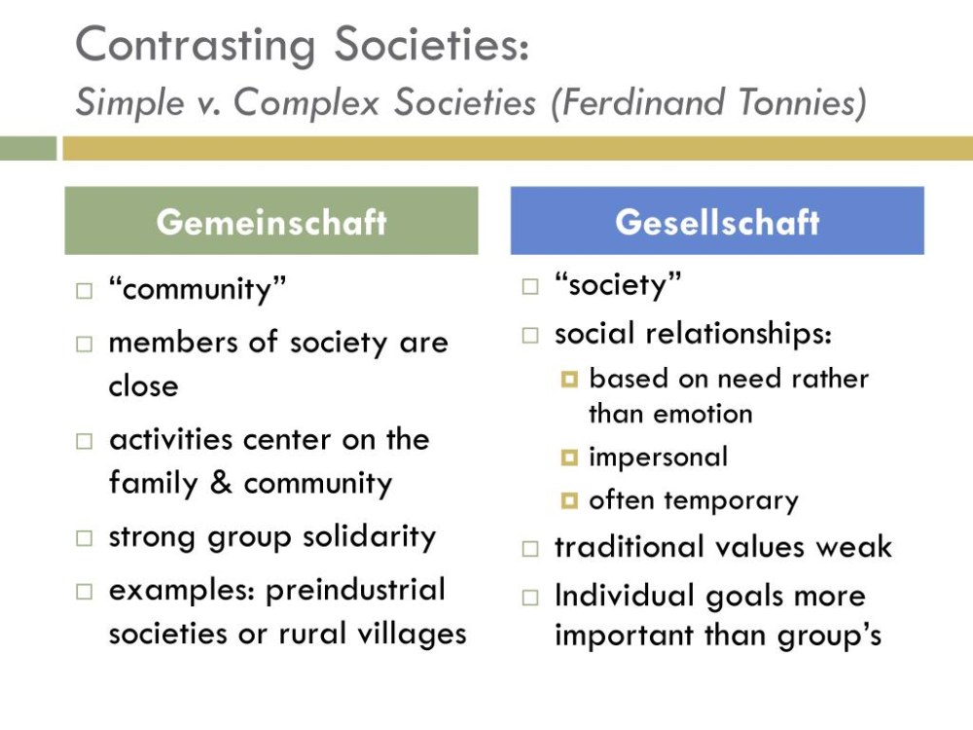
Gesellschaft, often translated as ” society “, refers to associations in which self-interest is the primary justification for membership. Or people who live and work very close together in proximity but very far apart relationally.

Slide 8
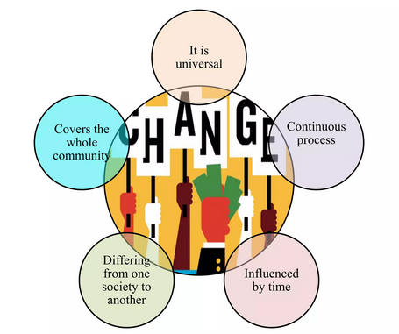
NATURE OF SOCIAL CHANGE

Slide 9
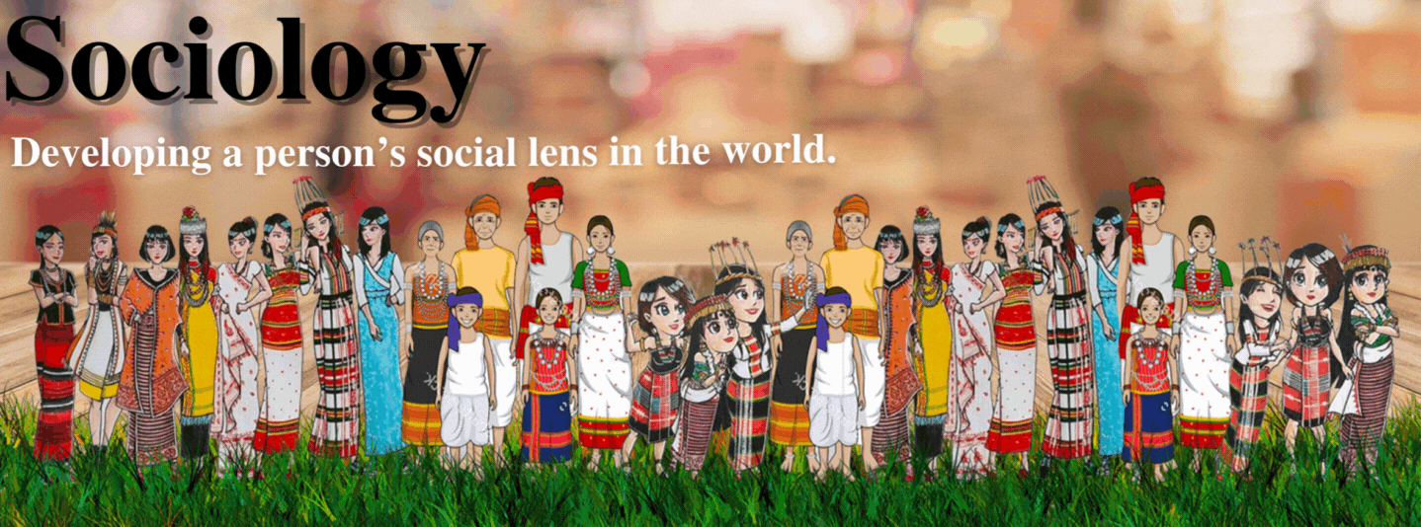
Main theories about social change:
1. Evolutionary Theories
2. Cyclical theories
3. Conflict theories
4. Functional theories

Slide 10
1. Evolutionary Theories
During the 19th century the evolutionary perspective became dominant to understand the process of social change.
Auguste Comte, Morgan, and Spencer were the major proponents of this theory.
They believed that society is the outcome of the constant process of evolution.
It starts with a simple beginning to a more complex form.
Evolutionary theorists consider social change in a positive sense. According to them, social change meant “progress” towards something better.
The theory was highly influenced by Darwin’s theory of organic evolution. The Darwinian model of biological evolution was applied by the evolutionary theorists who considered society as an organism to understand social evolution.

Slide 11
2. Cyclical theories
The cyclical theory of social change focuses on the rise and fall of civilizations and attempts to discover the patterns of growth and decay.
It focuses on the fact that civilization have always risen and fallen. Like an organism, all civilizations have a life-like birth, maturity, old age and death.
Sorokin, Toynbee, Spengler are the major theorists of this school of thought of social change.
They hold that all civilizations go through the cycles of growth and decay.

Slide 12
Spengler has criticized the evolutional theories of social change and said that change never happens in a straight line. In view of Spengler, social change occurs in a cycle, from where we start after roaming, we again reach the same place.
Example: The Roman Empire rose to power and then gradually collapsed.
The British empire grew strong, and then deteriorated.
Spengler believed that social change may take the form of progress or of decay, but that no society lives for ever.

Slide 13
3. conflict theories
Conflict theory views social conflict as the constant, and change as the result of this conflict.
Since conflict is continuous, change is continuous.
Change produces new interest groupings and classes, and conflict between these produces further change.
Any particular change represents the success of victorious groups or classes in imposing their preferences upon others.
A number of social theorists have espoused this approach such as Karl Marx, Lewis Coser, and Ralf Dahrendorf.

Slide 14
Marx and other conflict theorists deem society as basically dynamic and not static. They consider conflict as a normal, not an abnormal process.
According to the conflict perspective, society is constantly in conflict over resources, and that conflict drives social change.

Slide 15
4. functional theories
In the middle decades of the 20th century a number of American sociologists shifter their attention from social dynamics to social statics or from social change to social stability.
Functionalists accept change as a constant which does not need to be “explained.”
Changes disrupt the equilibrium of a society, until the change has been integrated into the culture.
Changes which prove to be useful (functional) are accepted and those which are useless or dysfunctional are rejected.

Slide 16
The functionalist theory of social change teaches that society is like a human body.
Each part is like an organ. Individual parts can't survive on their own.
Emile Durkheim, a major leader in the social sciences, believed that all parts of a society must be harmonious.
Example: the government provides education for the children of the family, which in turn pays taxes on which the state depends to keep itself running.

Slide 17
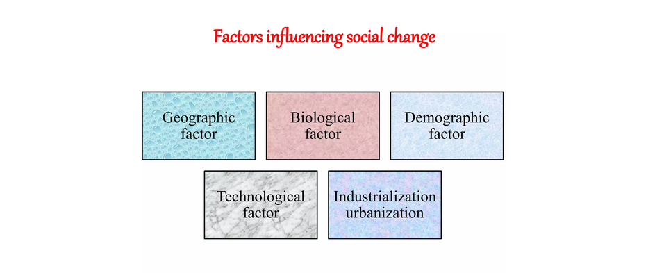
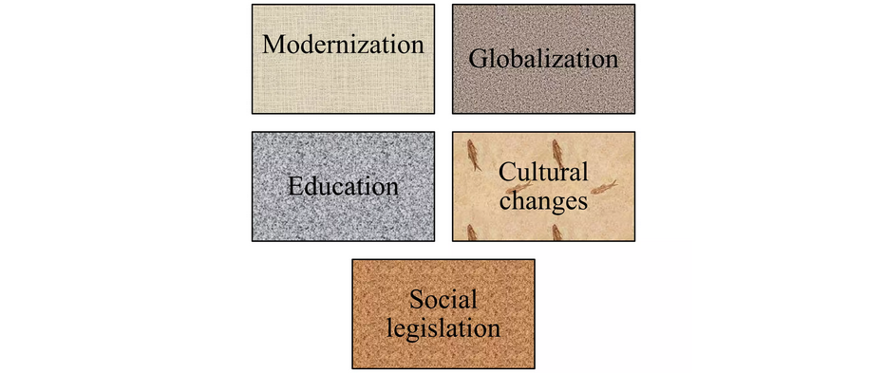
FACTORS INFLUENCING SOCIAL CHANGE
1.Natural Factors
2.Cultural Factors
3.Science and Technology Factors/ Globalization
4.Biological Factors
5.Demographic Factors

Slide 18
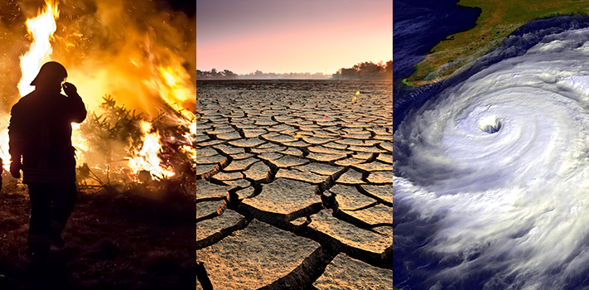
1. Natural Factors:
A storm, earthquake, flood, drought, disease and similar natural events even today can disrupt the social system.
Natural calamities like floods, earthquakes, draughts, famines and other natural disasters always force changes in the social conditions and life of the affected people.

Slide 19
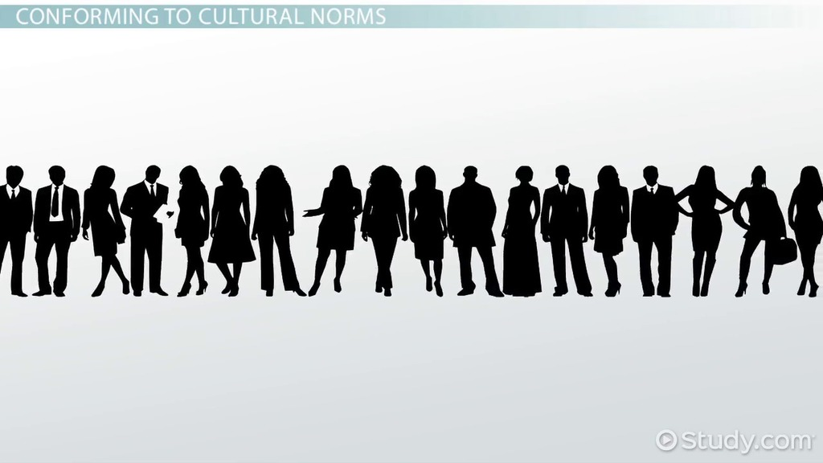
2.Cultural Factors:
The cultural factors also play a role in bringing about social change.
Our social life depends upon our beliefs, ideas, values, customs, conventions, institutions and the like. When there is a change in these, it influences the social life.
For example, let us (consider the system of marriage. The relations between the parents and children have undergone a big change. The new love and need for working couples has acted as a source of big change in family relations and culture. Thus, socio-economic and cultural factors always act as big and formidable factors of social change

Slide 20

3.Science and Technology factors:
In contemporary times science and technology happens to be the most important factor of social change. New scientific inventions and technologies always greatly influence the social life.
Technology brings about changes in the physical environment and the material culture of each society which in turn gives birth to social change.

Slide 21
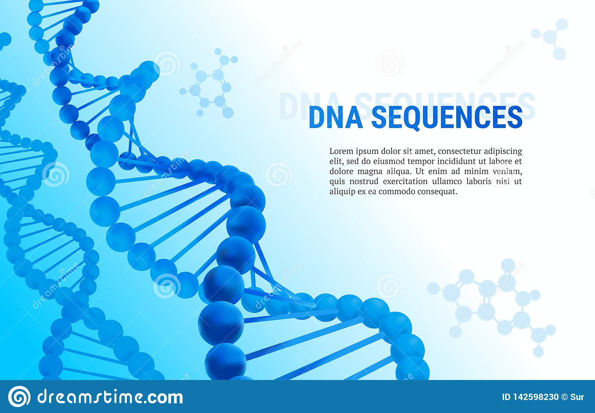
4. Biological Factors:
Biological factors also affect social change.
Biological factors are those factors which determine the structure, selection and hereditary qualities of generations.
The human element is ever changing. Each new generation is different from previous generation.
It is different in form, ideas and in many other ways from the one gone before.

Slide 22

5. Demographic Factors:
The Demographic factors always influence the process and nature of Social Change. The population increase or decrease always brings social problems. When the birth-rate in a society exceeds death-rate, population begins to rise.
A constantly rising population gives birth to poverty, unemployment, disease and several other related problems.
On the other hand, a low birth-rate means leads to decrease in the size of the population. When population is low, there are fewer skilled hands available and the country cannot make full use of the natural resources.
The social conditions deteriorate the size of families shrink and it affects the social relations

Slide 23
THANK YOU|!☺

